Slide 1
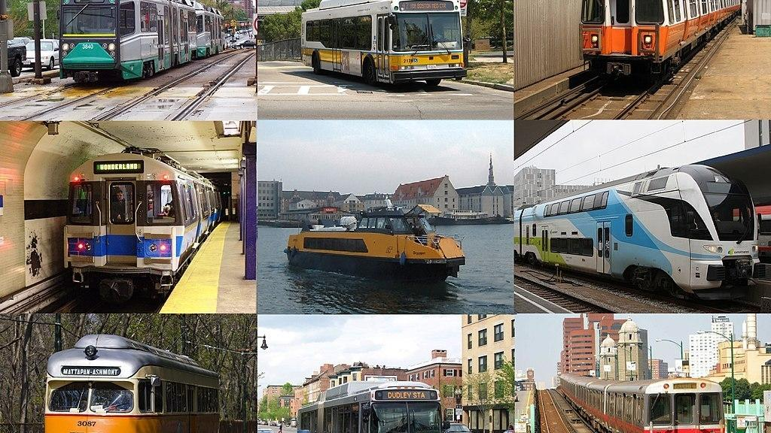
Public transport efficiency and analysis
Present By:
B.Ebinesh

Slide 2
Contents:
Introduction
Proposed Methodology
Sustainable energy
Efficience Transport
Tranaport Cost And Benifits
Advantages
Disadvantages

Slide 3
Introduction:
Transport service efficiency analysis are based in three basic inputs: labor, gas, and capital.
Labor may be represented by total number of employees (operational, maintenance, and administrative) or by the total labor cost.
Gas used is obtained directly in gallons or litters per year.

Slide 4
Proposed Methodology
The proposed methodology makes use of both qualitative and quantitative perspectives, and includes a broad array of approaches such as literature reviews, expert opinions, focus groups, and content validation.

Slide 5
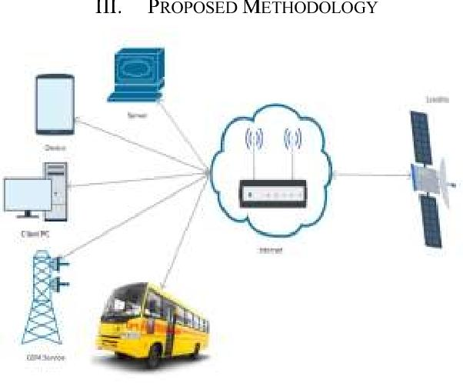
Proposed Methodology

Slide 6
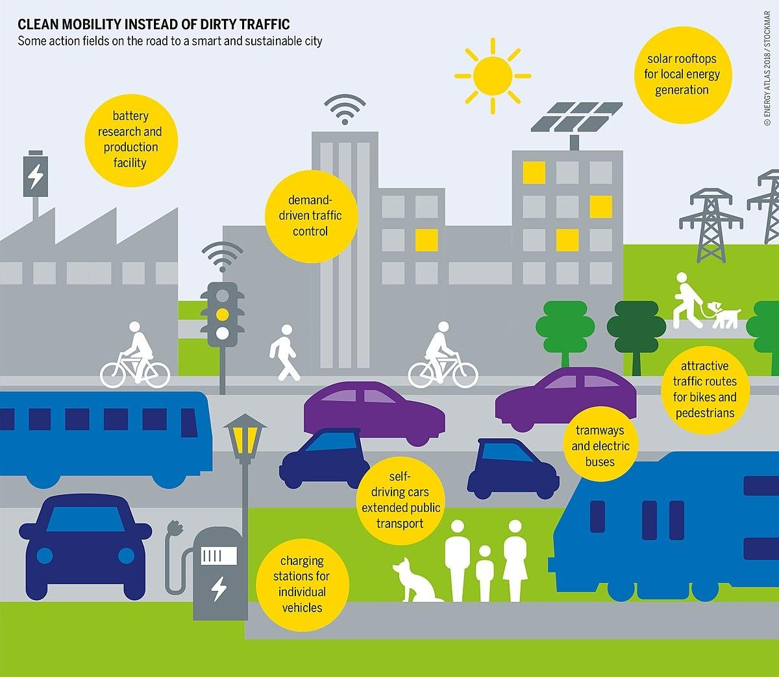
Sustainable Energy

Slide 7
Sustainable Energy
Sustainable transportation refers to low- and zero-emission, energy-efficient, affordable modes of transport, including electric and alternative-fuel vehicles, as well as domestic fuels.
Traveling by rail within cities or across long distances releases the least amount of greenhouse gasses into the air out of all forms of transportation.

Slide 8
Efficiency Transport
Transportation efficiency means the number of vehicle trips by employees, visitors, or customers of the residential, retail, commercial, sports, cultural, entertainment, or recreational use project divided by the total number of employees, visitors, and customers.

Slide 9
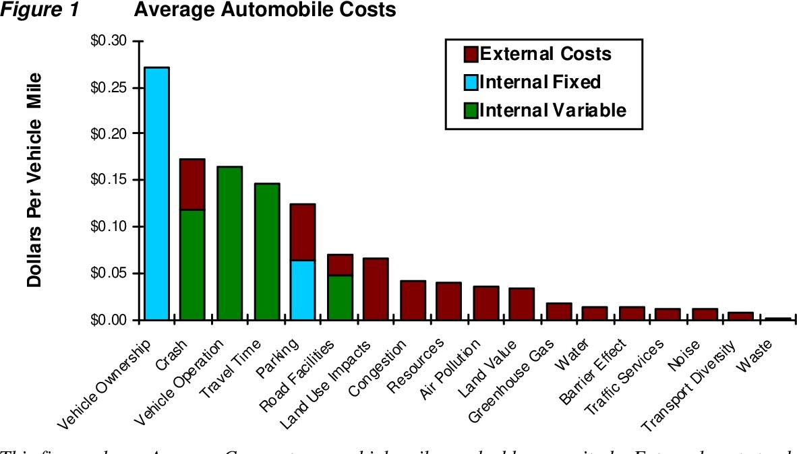
Transport Cost Benifits

Slide 10
Advantages:
Improves Fuel Efficiency. One of the most technical benefits of public transportation is the ability to outfit buses and other public transit vehicles with alternative fuel sources.
Some systems are completely electric or utilize renewable resources for fuel.

Slide 11
Disadvantages:
Peak-hour crowding. Traffic congestion. Inadequate service during off-peak hours, holidays, and weekends. High infrastructure maintenance cost. Increased risk of infectious diseases. Long waiting times during peak hours.

